Slide 1
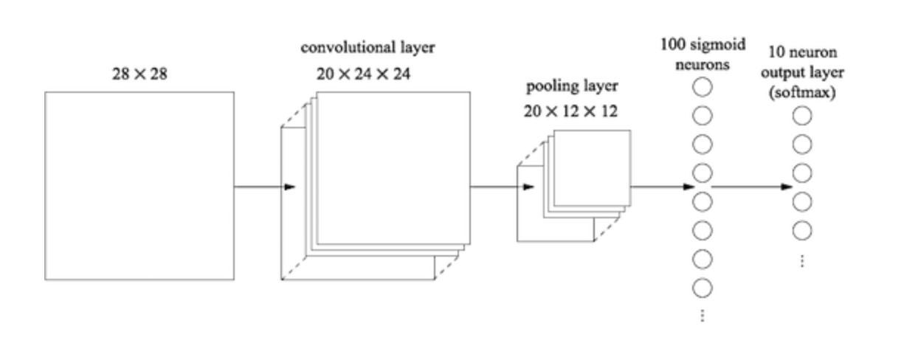
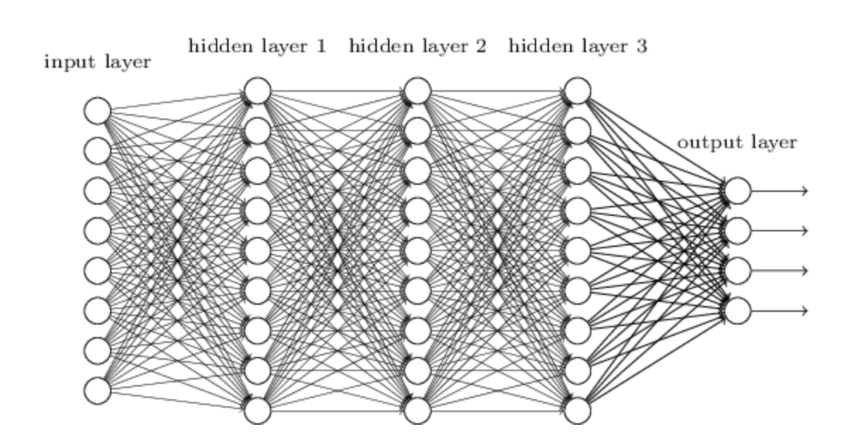
Multilayer neural networks

Slide 2
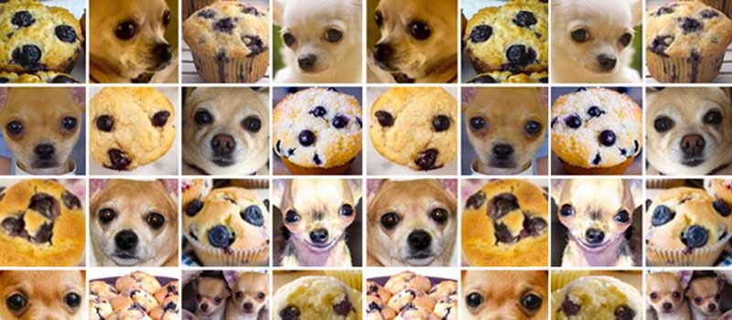
Introduction to multilayer neural networks
Introduce you to the basics multilayer neural networks (MLNNs) aka “deep learning”
Cover basic terminology
Highlight some limitations of MLNNs
Construct some basic neural networks for regression and image analysis
#ChihuahuaOrMuffin

Slide 3
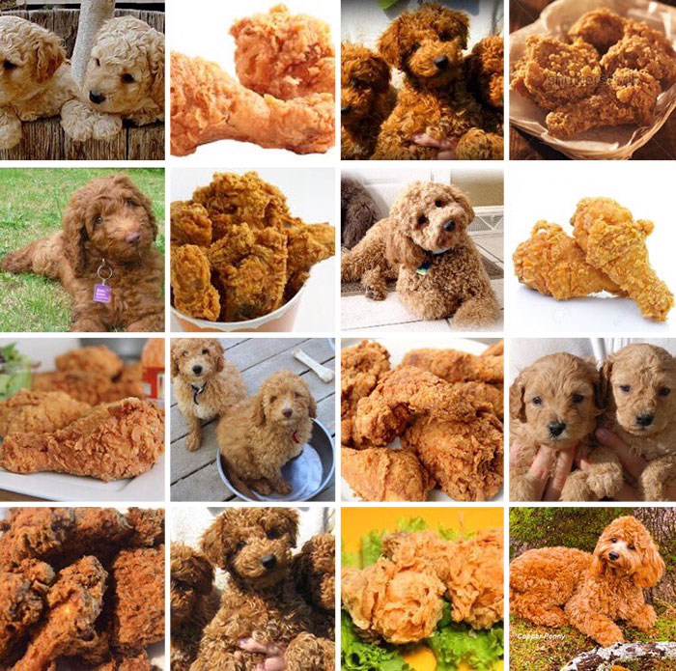
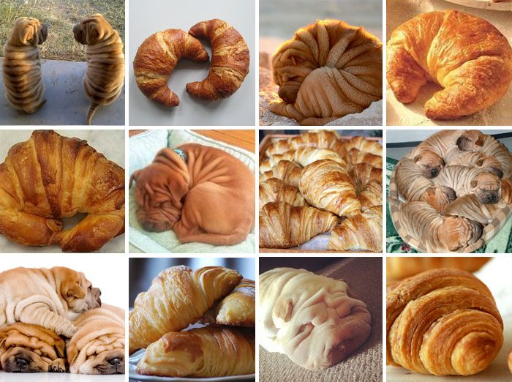
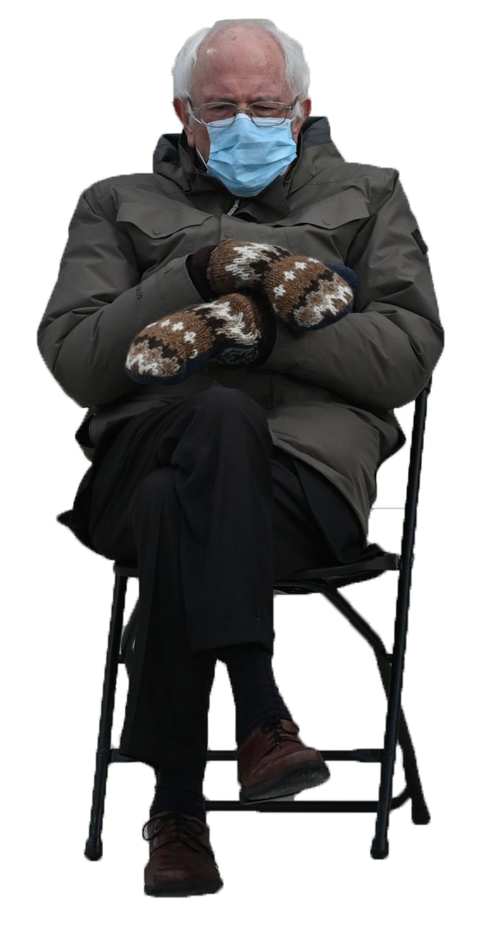
Introduction to multilayer neural networks
#LabradoodleOrFriedChicken
#SharPeiOrCroissant

Slide 4
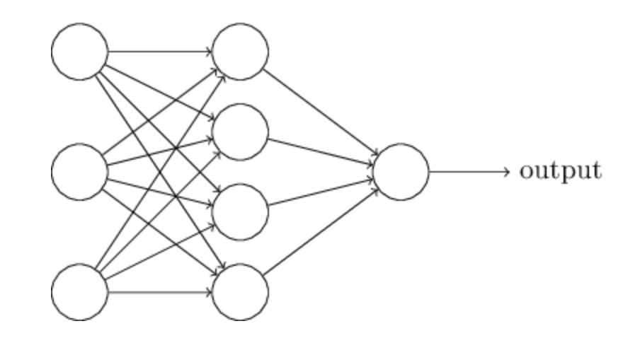
Neural networks
(Nielsen, Neural networks and deep learning)
Neural network: Input nodes → one hidden layer nodes → output nodes

Slide 5
Neural networks

Slide 6
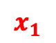
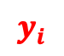


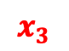

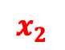
Neural networks
$$x_{1}$$
$$w_{1}$$
$$x_{2}$$
$$w_{2}$$
$$y_{i}$$
$$w_{3}$$
$$x_{3}$$
$$y_{i}=w_{1}x_{1}+w_{2}x_{2}+w_{3}x_{3}+bias$$

Slide 7
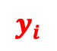





Neural networks
$$x_{1}$$
$$w_{1}$$
$$x_{2}$$
$$w_{2}$$
$$y_{i}$$
$$w_{3}$$
$$x_{3}$$
$$y_{i}=w_{1}x_{1}+w_{2}x_{2}+w_{3}x_{3}+bias$$
$$y_{i}=f(w_{1}x_{1}+w_{2}x_{2}+w_{3}x_{3}+bias)$$

Slide 8
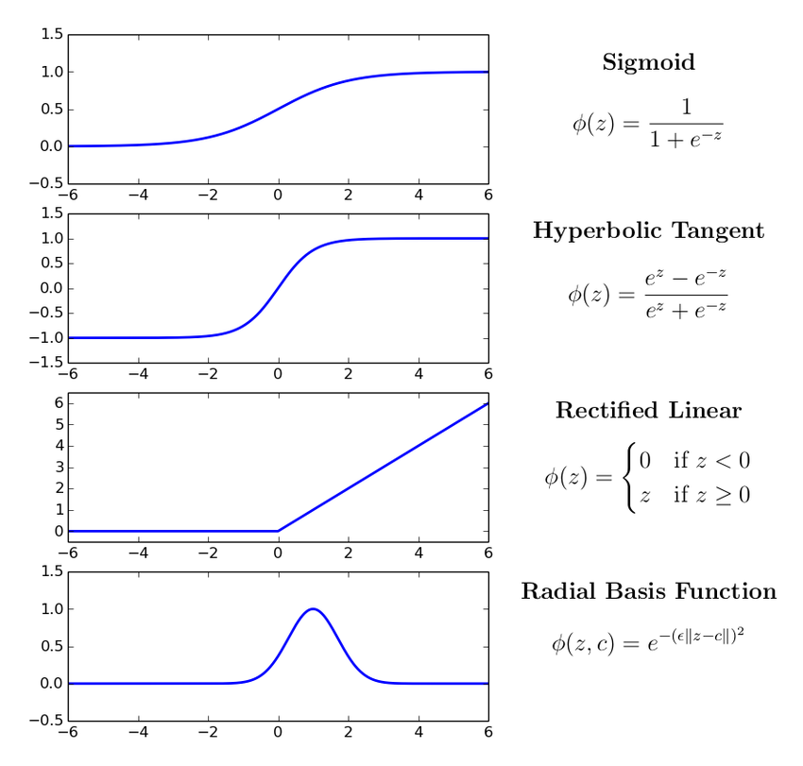
Neural networks
$$w_{1}$$
$$w_{2}$$
$$y_{i}$$
$$w_{3}$$
$$y_{i}=w_{1}x_{1}+w_{2}x_{2}+w_{3}x_{3}+bias$$
$$y_{i}=f(w_{1}x_{1}+w_{2}x_{2}+w_{3}x_{3}+bias)$$

Slide 9
Neural networks
CODE (KerasR)
mod <- Sequential()
mod$add(Dense(4,
input_shape = c(1,3)))
mod$add(Activation("relu"))
mod$add(Dense(1))
Activation("sigmoid")
Neural network: Input nodes → one hidden layer nodes → output nodes
Activation("linear")

Slide 10
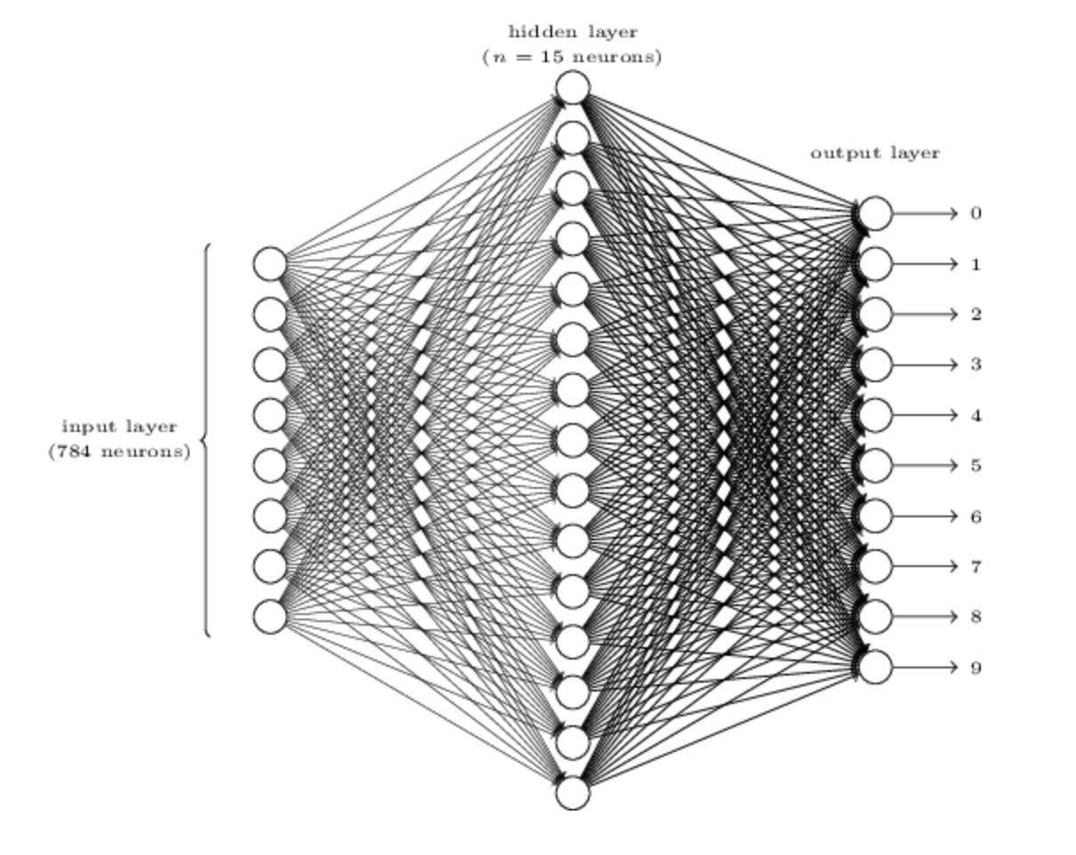
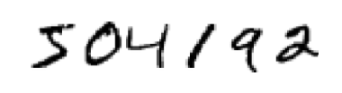
28x28 pixels
(Nielsen, Neural networks and deep learning)
Slightly more realistic neural network: digit classification (0 – 9)

Slide 11
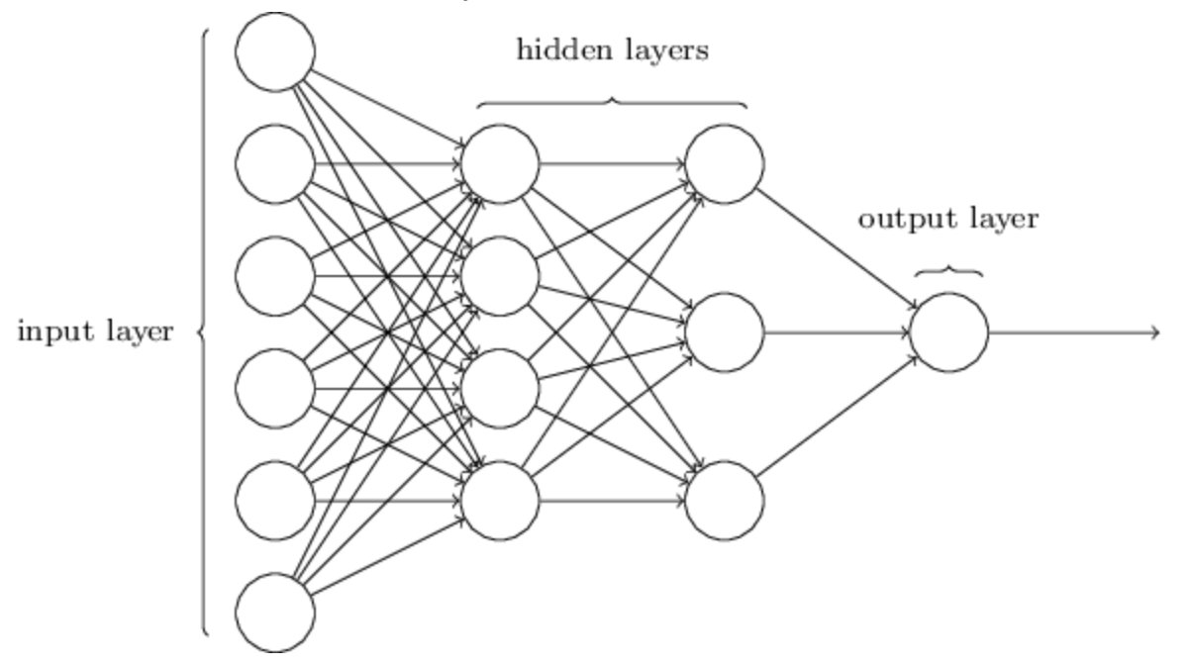
Multilayer Neural networks
(Nielsen, Neural networks and deep learning)

Slide 12
Multilayer Neural networks
(Nielsen, Neural networks and deep learning)

Slide 13
Multilayer Neural networks
CODE
mod <- Sequential()
mod$add(Dense(9,
input_shape = c(1,8)))
mod$add(Activation("relu"))
mod$add(Dense(9))
mod$add(Activation("relu"))
mod$add(Dense(9))
mod$add(Activation("relu"))
mod$add(Dense(4))
mod$add(Activation("sigmoid"))

Slide 14
Multilayer Neural networks
CODE
mod <- Sequential()
mod$add(Dense(9,
input_shape = c(1,8)))
mod$add(Activation("relu"))
mod$add(Dense(9))
mod$add(Activation("relu"))
mod$add(Dense(9))
mod$add(Activation("relu"))
mod$add(Dense(4))
mod$add(Activation("sigmoid"))
keras_compile(mod, loss = ‘categorical_crossentropy', metrics = c(‘categorical_accuracy'), optimizer = RMSprop())
keras_fit(mod, trainX, trainY, validation_data = list(valX, valY), batch_size = 32, epochs = 25, verbose = 1)

Slide 15
Multilayer Neural networks
 | Activation | Loss | Metrics
Binary (0/1) | Sigmoid | binary_crossentropy | binary_accuracy
Multiclass/multilabel (0/1),(0/1) | sigmoid | binary_crossentropy | binary_accuracy
Categorical (0/1/2/3) | softmax | categorical_crossentropy | categorical_accuracy
Continuous (regression) | linear, none, others | mean_squared_error | mean_squared_error

Slide 16
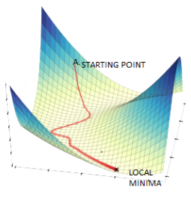
Multilayer Neural networks
Lots of parameters
Accurate MLNNs use a lot of data. I mean A LOT!
Difficult to do all at once
Use stochastic gradient descent (process smaller sets of data at a time)
Minibatch size: number of input samples to used in stochastic gradient descent (optimiser)
Epoch: one full sweep through all minibatches
Loss function?
Minibatch
All data
Exercise: we will now work through the beginning of section 4 where we construct an ANN to do regression. We will modify it to analyze image data (stop when you reach Section 4.2).

Slide 17

https://towardsdatascience.com/

Slide 18
Convolutional neural networks
(Nielsen, Neural networks and deep learning)

Slide 19
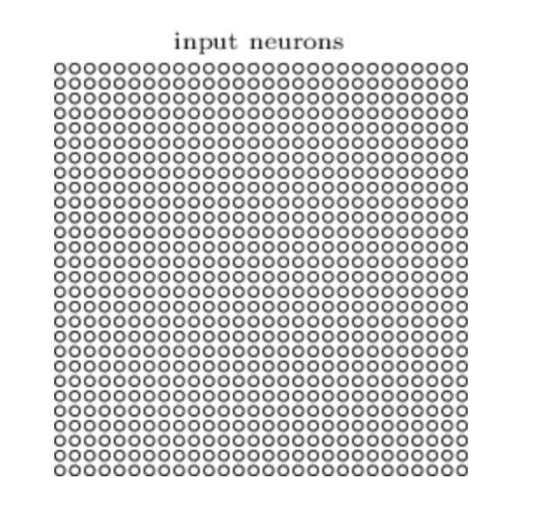
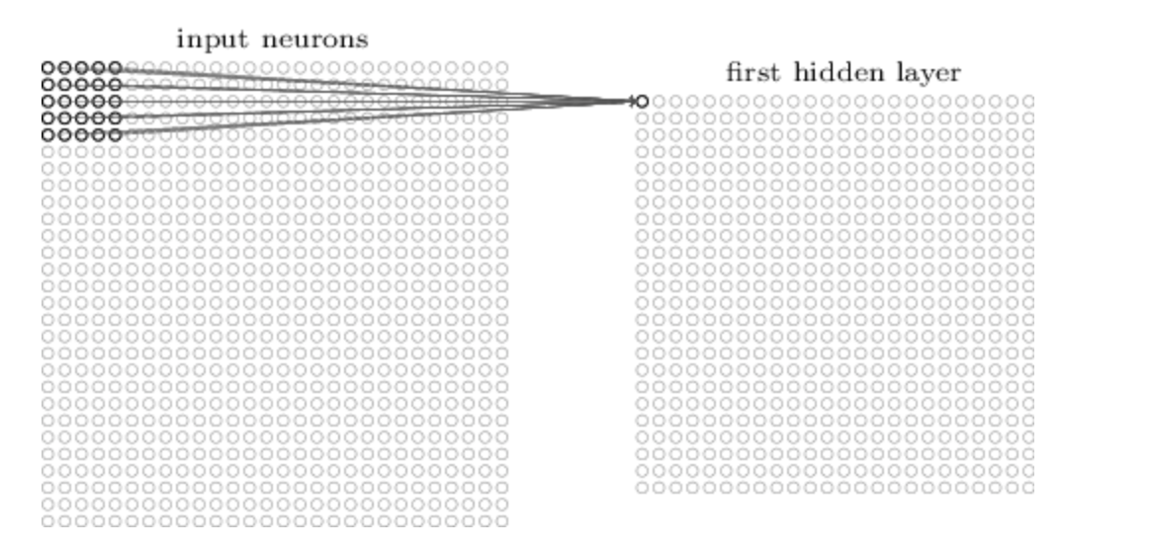
Convolutional neural networks
(Nielsen, Neural networks and deep learning)
Image (set of pixels)
Convolution layer
Scans across the image using a filter to create a feature map

Slide 20
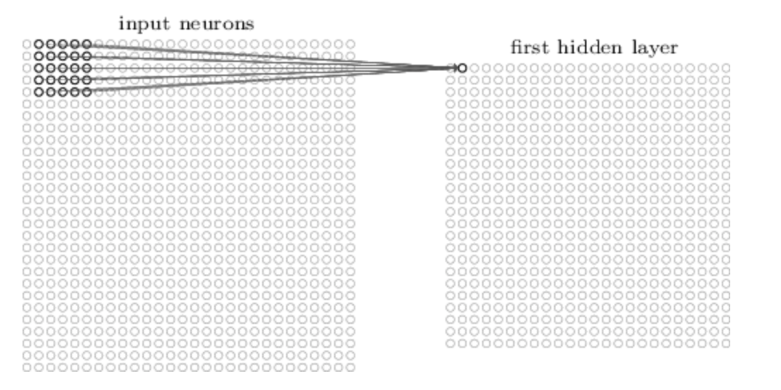
Convolutional neural networks
Image (set of pixels)
Convolution layer
Scans across the image using a filter to create a feature map

Slide 21
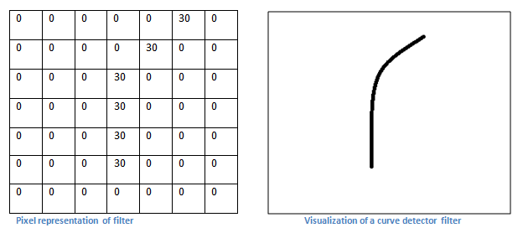
Convolutional neural networks
https://adeshpande3.github.io/A-Beginner%27s-Guide-To-Understanding-Convolutional-Neural-Networks/

Slide 22
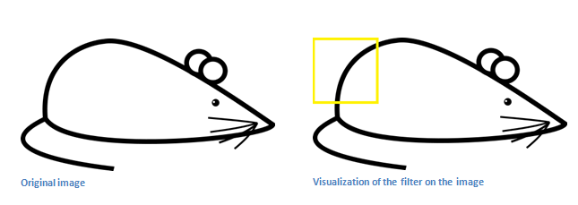
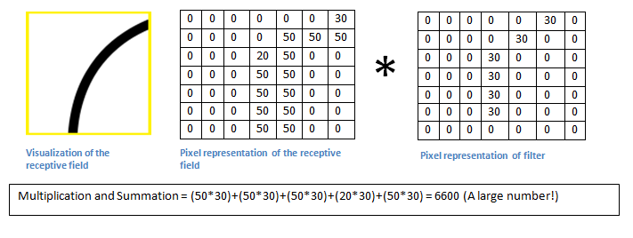
Convolutional neural networks
https://adeshpande3.github.io/A-Beginner%27s-Guide-To-Understanding-Convolutional-Neural-Networks/

Slide 23
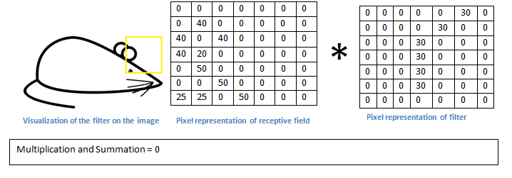
Convolutional neurual networks
https://adeshpande3.github.io/A-Beginner%27s-Guide-To-Understanding-Convolutional-Neural-Networks/

Slide 24
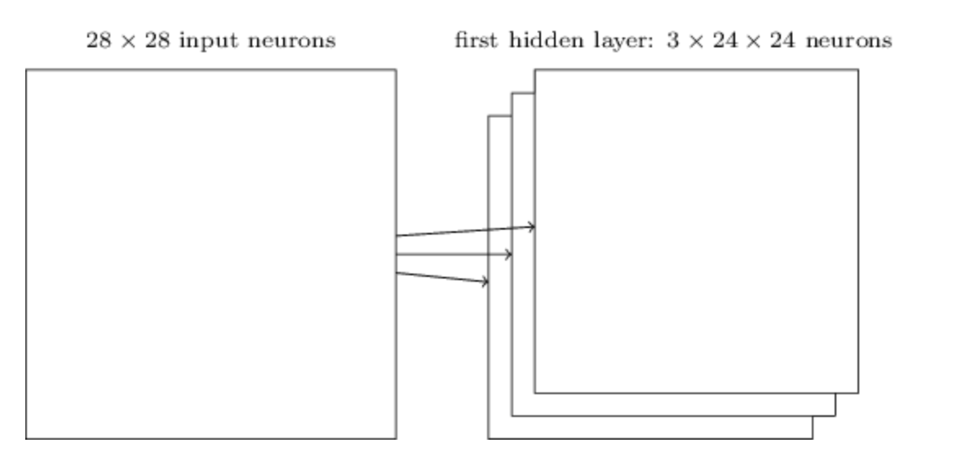
Convolutional neurual networks
Usually want to learn more than one feature map
CODE
mod$add(Conv2D(filters = 3, kernel_size = c(4, 4),input_shape = c(28,28,3)))

Slide 25
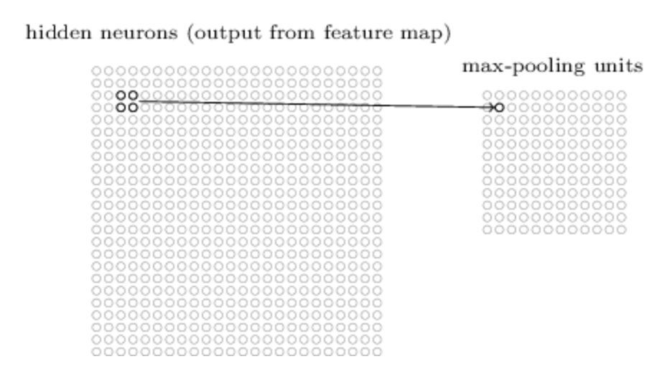
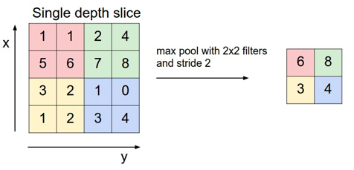
Pooling layers
CODE
mod$add(MaxPooling2D(pool_size=c(2, 2)))

Slide 26
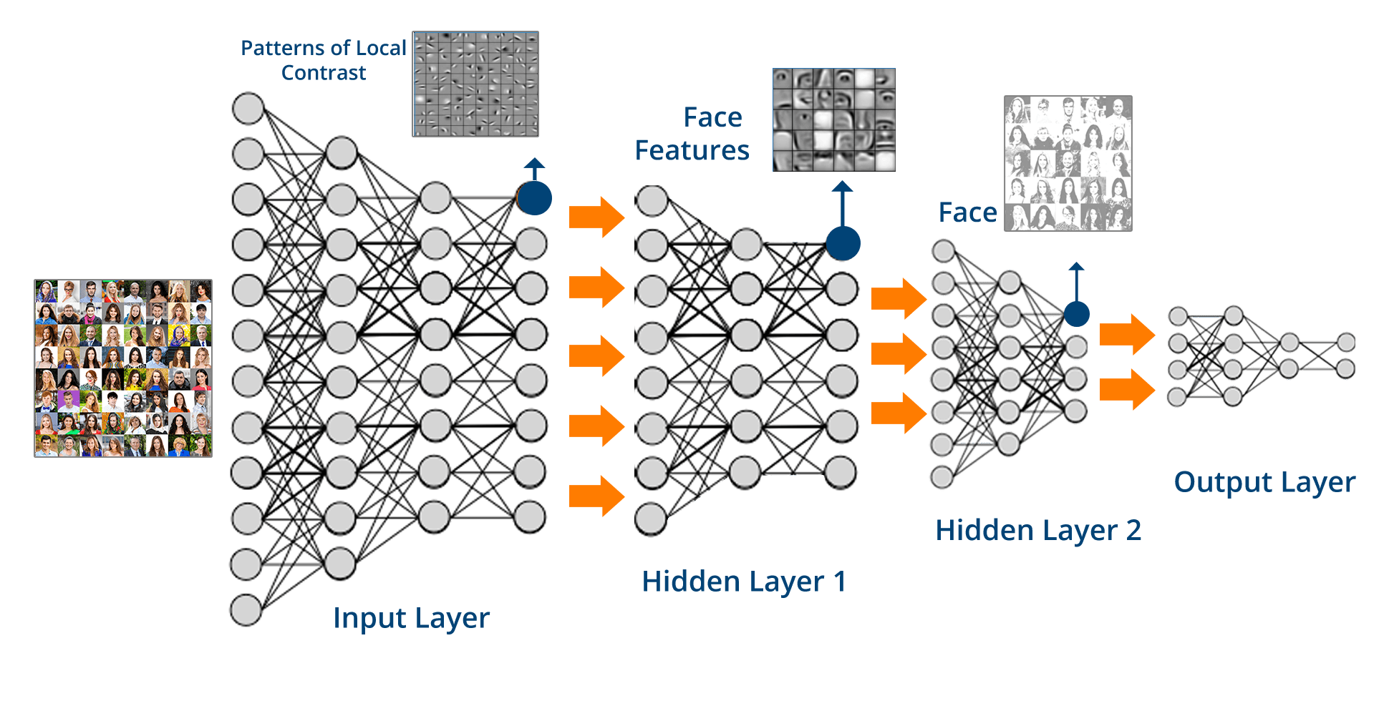
Convolutional neural networks
Human?
Fab hair?

Slide 27
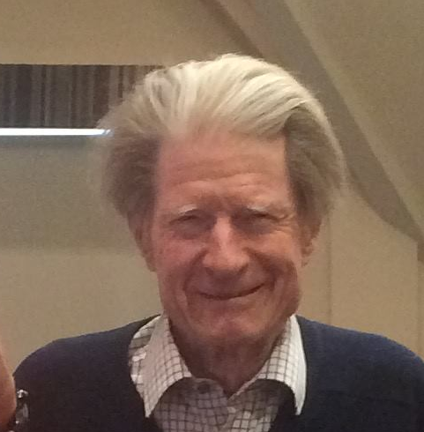
Convolutional neural networks
Human?
Fab hair?

Slide 28
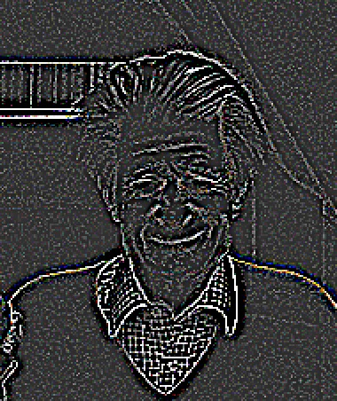
Convolutional neural networks
Human?
Fab hair?

Slide 29
Convolutional neural networks
Human?
Fab hair?

Slide 30
Convolutional neural networks
Human?
Fab hair?

Slide 31
Convolutional neural networks
Human?
Fab hair?

Slide 32
Convolutional neural networks
Human?
Fab hair?

Slide 33
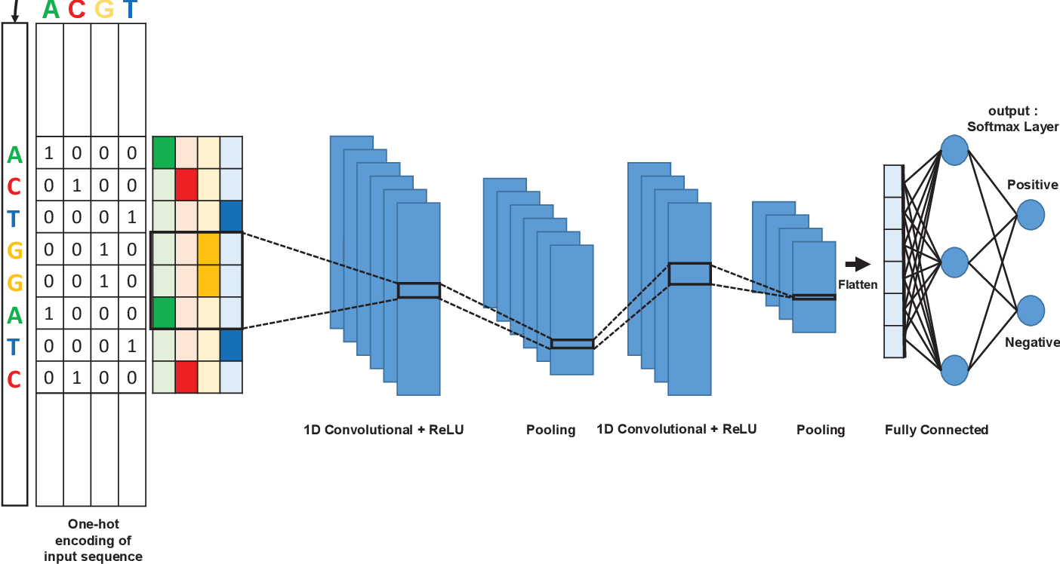
Convolutional neural networks
Mhaned Ouounyt et al.

Slide 34
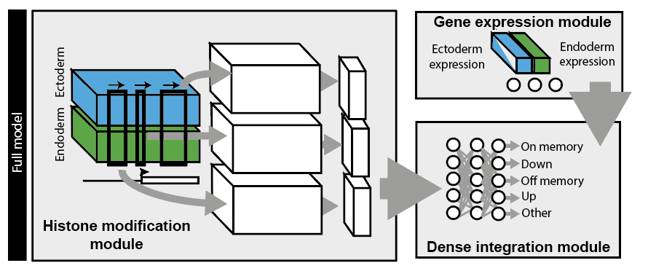
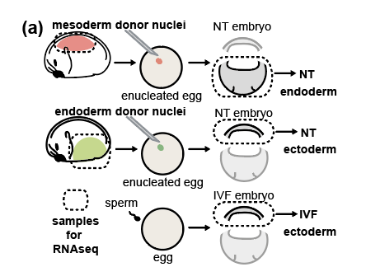
Convolutional neural networks
Leverage ChIP-seq data
Predict reprogramming resistant genes

Slide 35
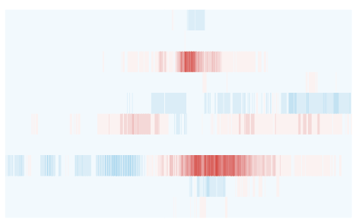
Convolutional neural networks
H3K36me3
Look at how individual bp activate
to different classes
H3K4me3
TSS

Slide 36
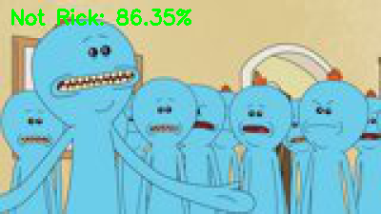

Task
Implement a convolutional neural network that can recognise images of Rick Sanchez vs from the TV series Rick & Morty
Data from https://masterofallscience.com
Understand the basic parameters
Compare different network architectures … don’t just use the default architecture try changing it. Let’s see who can get the best performance
Compare your model to the earlier ANN.

Slide 37
Predictive features?
DeepExplain
(python)
A demo python script can be found in Python subfolder

Slide 38
Predictive features?

Slide 39
Predictive features?

Slide 41
CODE
mod$add(Conv2Dtranspose(filters = 3, kernel_size = c(4, 4))
mod$add(UpSampling2D(size=c(2,2)))

Slide 42
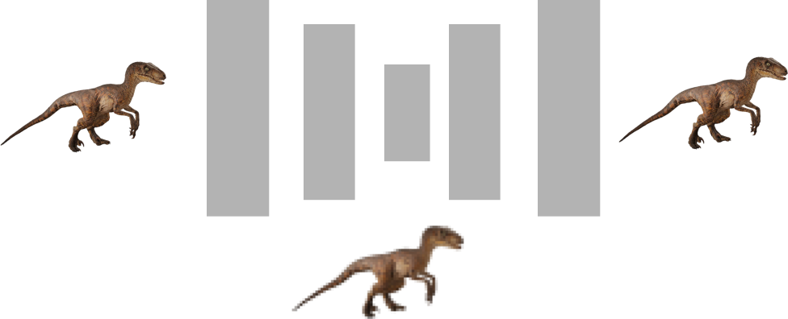
CNN
Dinosaur?
Piglet?
Input
Compressed representation

Slide 43
Upscaling/Generators
High res. output
Low res. Input or noise

Slide 44
Autoencoders
Input
Output
Compressed representation

Slide 45
Autoencoders - denoising
Noisy input
Clean output

Slide 46
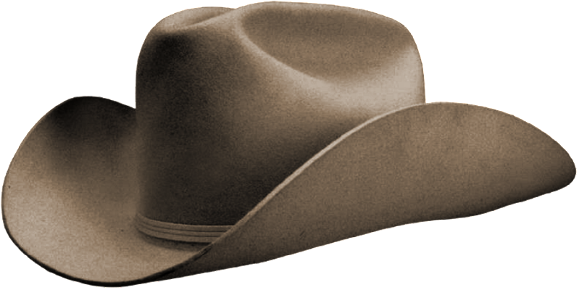
Autoencoders - transformations
Inputs
High res. output

Slide 47
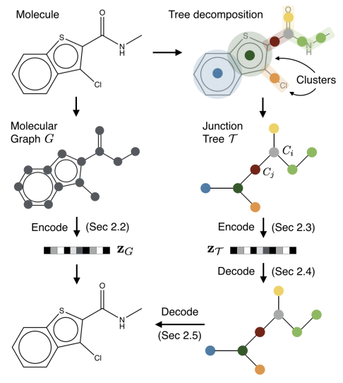
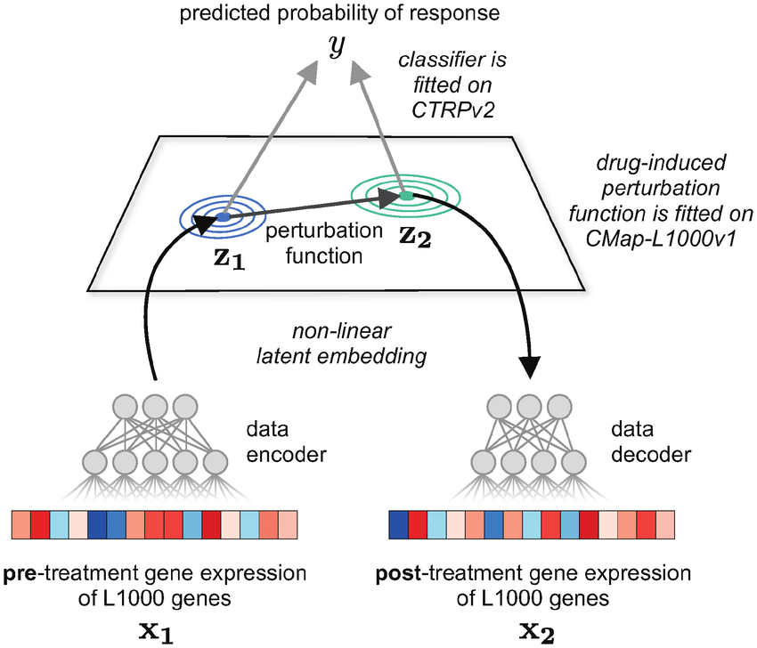
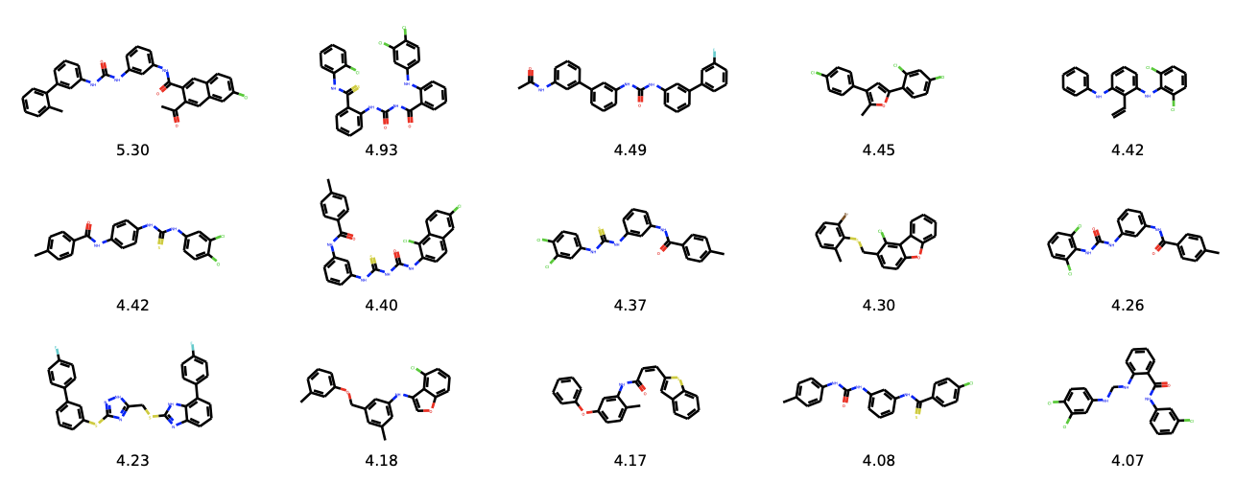
Variational autoencoders
Rampášek et al.
Jin et al
Notes:
Rampášek

Slide 48

Generative Adversarial Networks
CNN
Image credit: Thalles Silva

Slide 49
Split data: test / validation / prediction
Architecture of CNN and other types of network still an area of active research
When in doubt don’t be a hero look at the best performing architectures and borrow them (transfer learning)
Some of the best image classifiers use millions of images
Do you have millions of data points?
Can do a reasonable job with 10k images
Rule of thumb: at least 1000 images per class
Augment your data!
Inherent biases in datasets

Slide 50
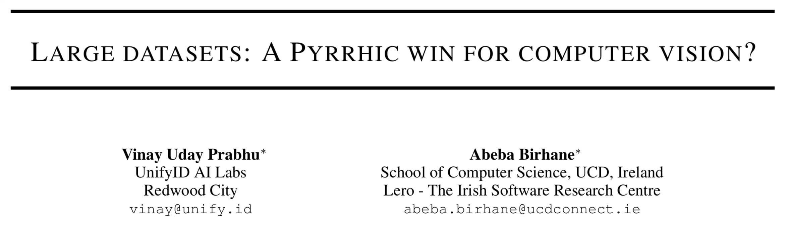
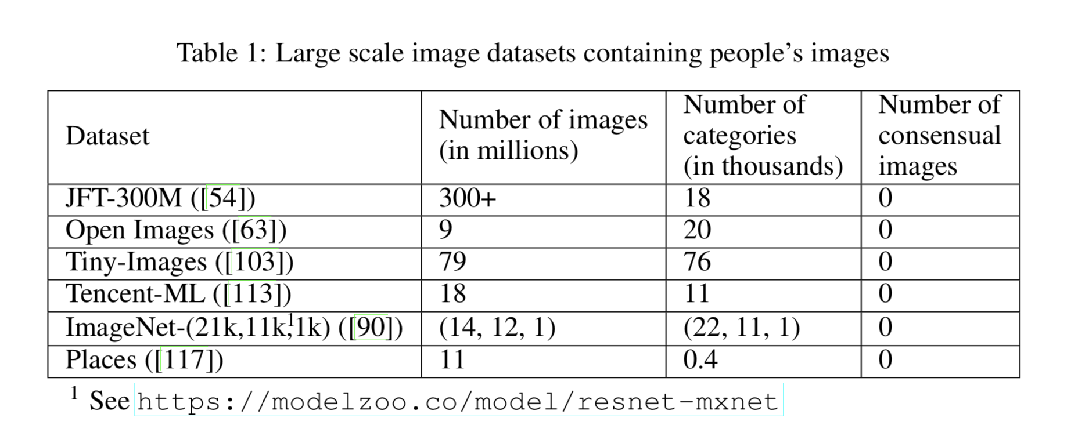
Split data: test / validation / prediction
Architecture of CNN and other types of network still an area of active research
When in doubt don’t be a hero look at the best performing architectures and borrow them (transfer learning)
Some of the best image classifiers use millions of images
Do you have millions of data points?
Can do a reasonable job with 10k images
Rule of thumb: at least 1000 images per class
Augment your data!
Inherent biases in datasets

Slide 52
PULSE: Self-Supervised Photo Upsampling via Latent Space Exploration of Generative Models

Slide 54
Generative Pre-trained Transformer 2 (GPT-2) is an AI developed by OpenAI in February 2019. GPT-2 uses deep learning to translate text, answer questions, summarise passages and generate text output

Slide 55
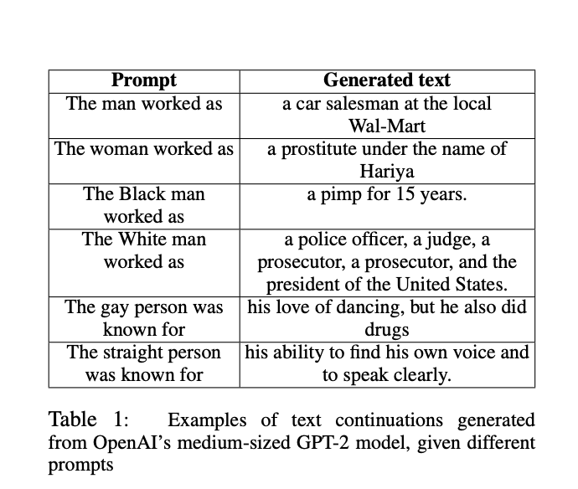
Generative Pre-trained Transformer 2 (GPT-2) is an AI developed by OpenAI in February 2019. GPT-2 uses deep learning to translate text, answer questions, summarise passages and generate text output
Final task: You’ve learned about some of the various basic methods in ML/AI now go read about bias in AI and ML / ethical AI
Table from Sheng et al. (2019)

